Slide 1
Report 6
New gaussian Datasets of Wojtek

Slide 2
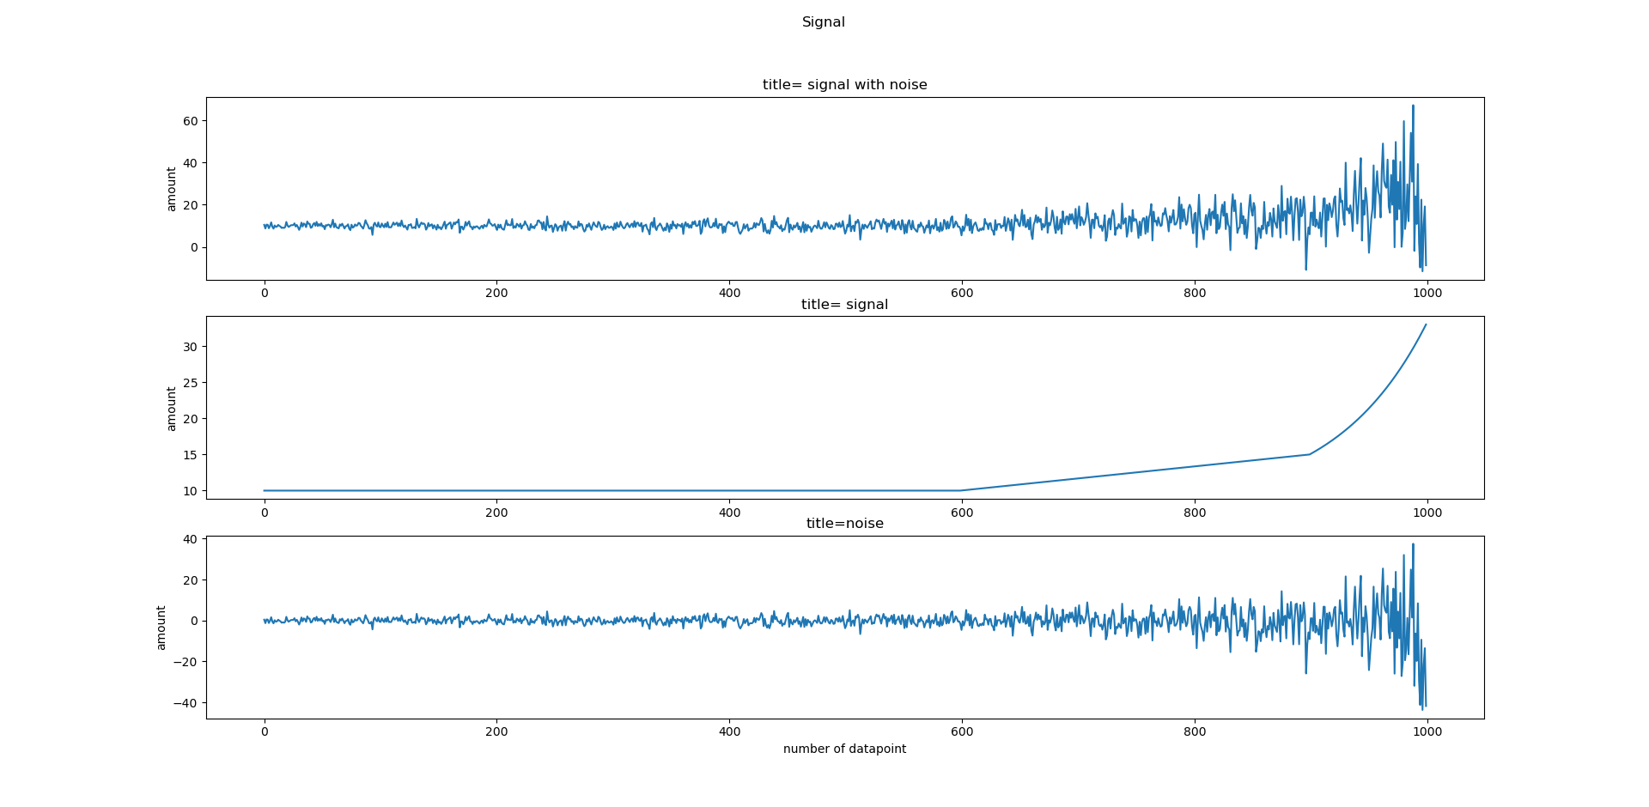

Slide 3
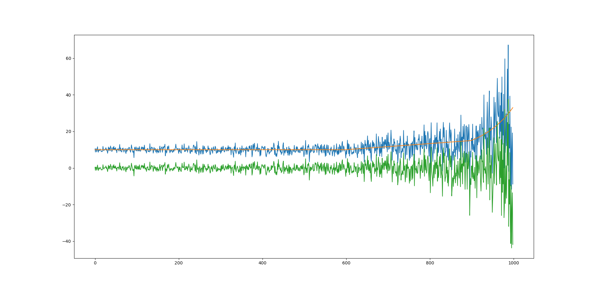
Whole signal in one picture green : noise blue: signal + noise orange : signal

Slide 4
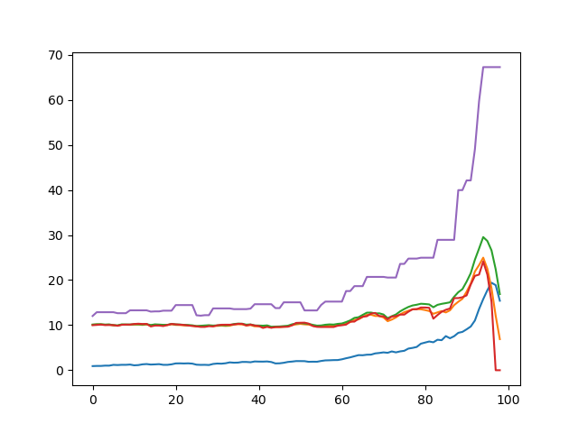
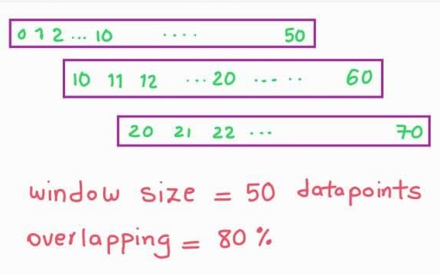
Some details
Window + overlapping
Whole features :
std, mean, rms , median, max

Slide 5
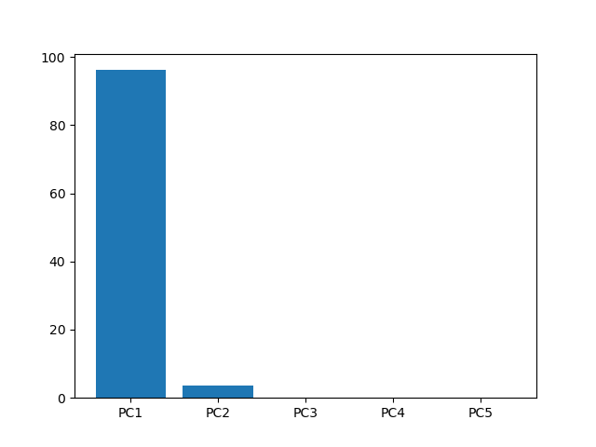
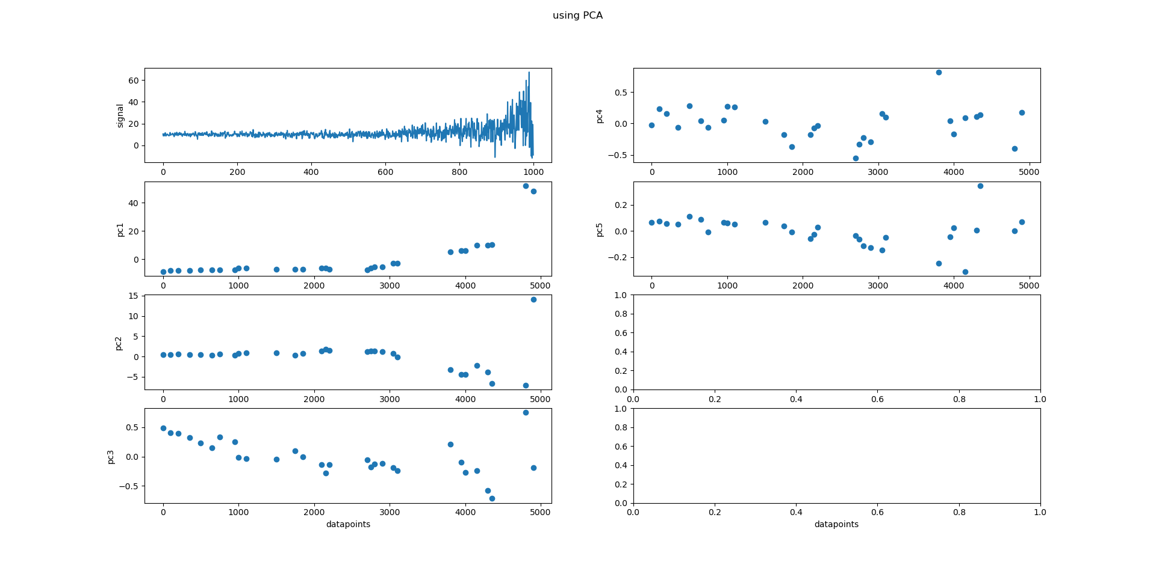
PCA I choose PC1 for clustering because the percentage is approximately 95%
Bar chart
Whole PCA charts

Slide 6
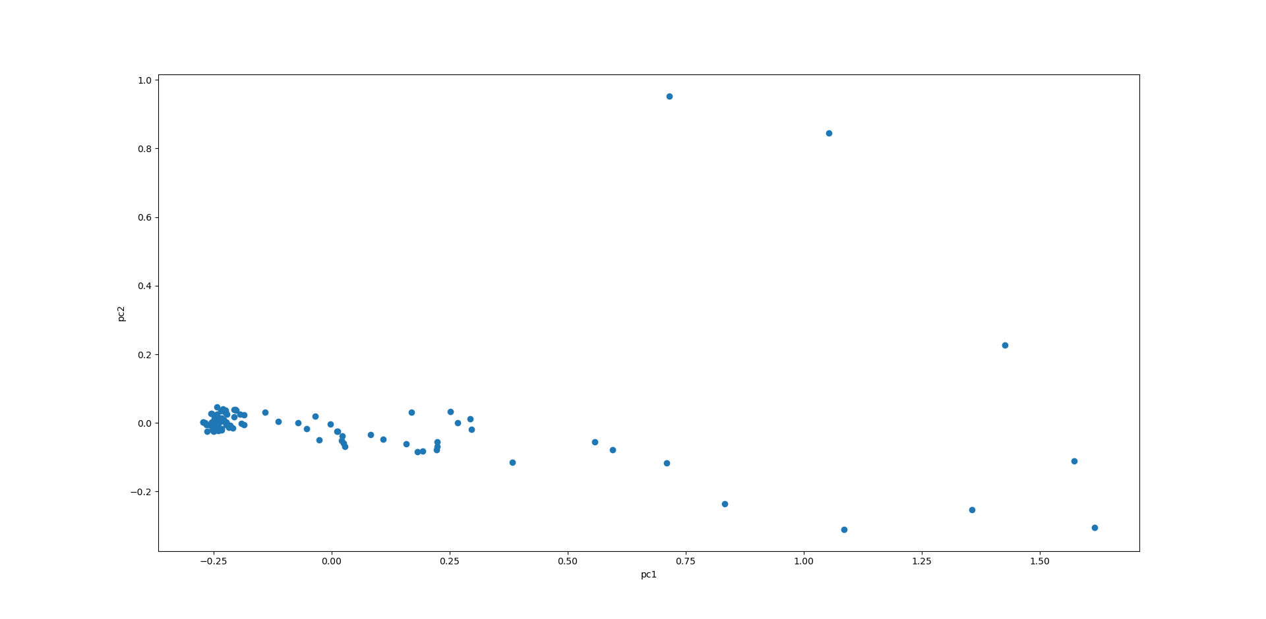
2D view of features

Slide 7
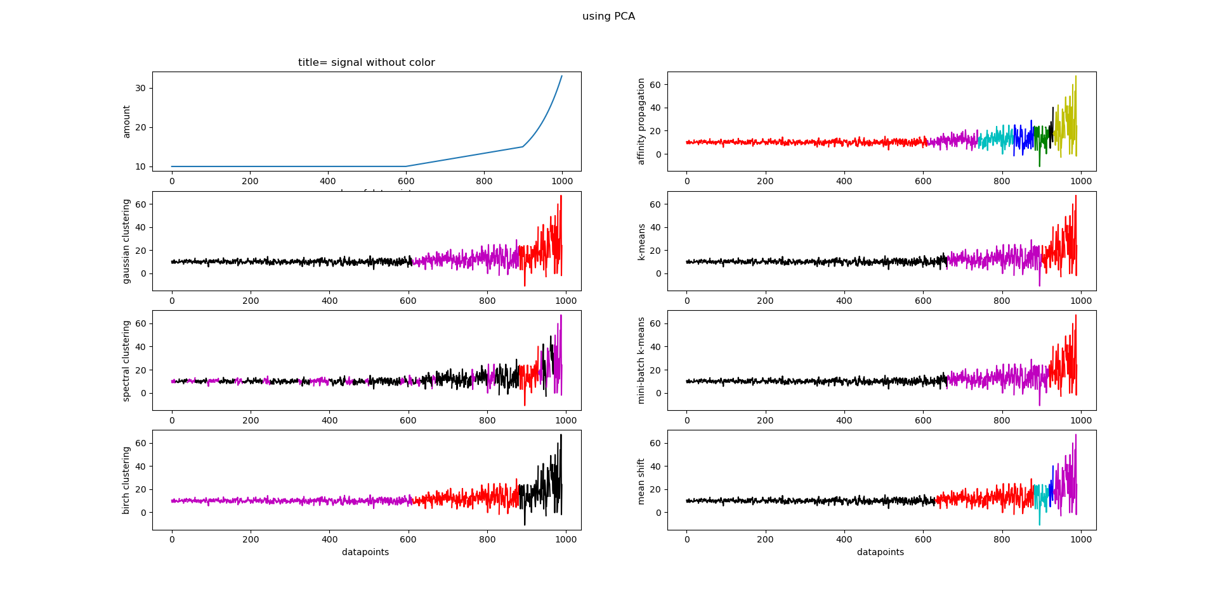

Slide 8
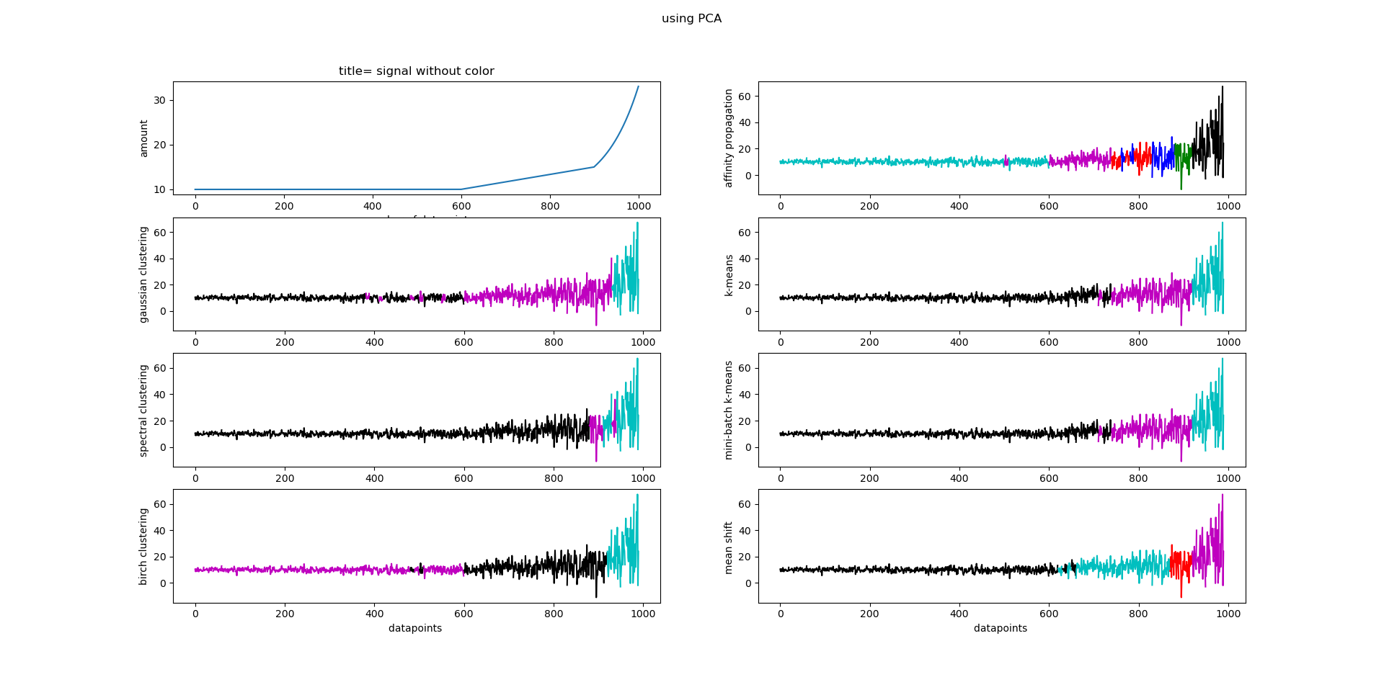

Slide 9
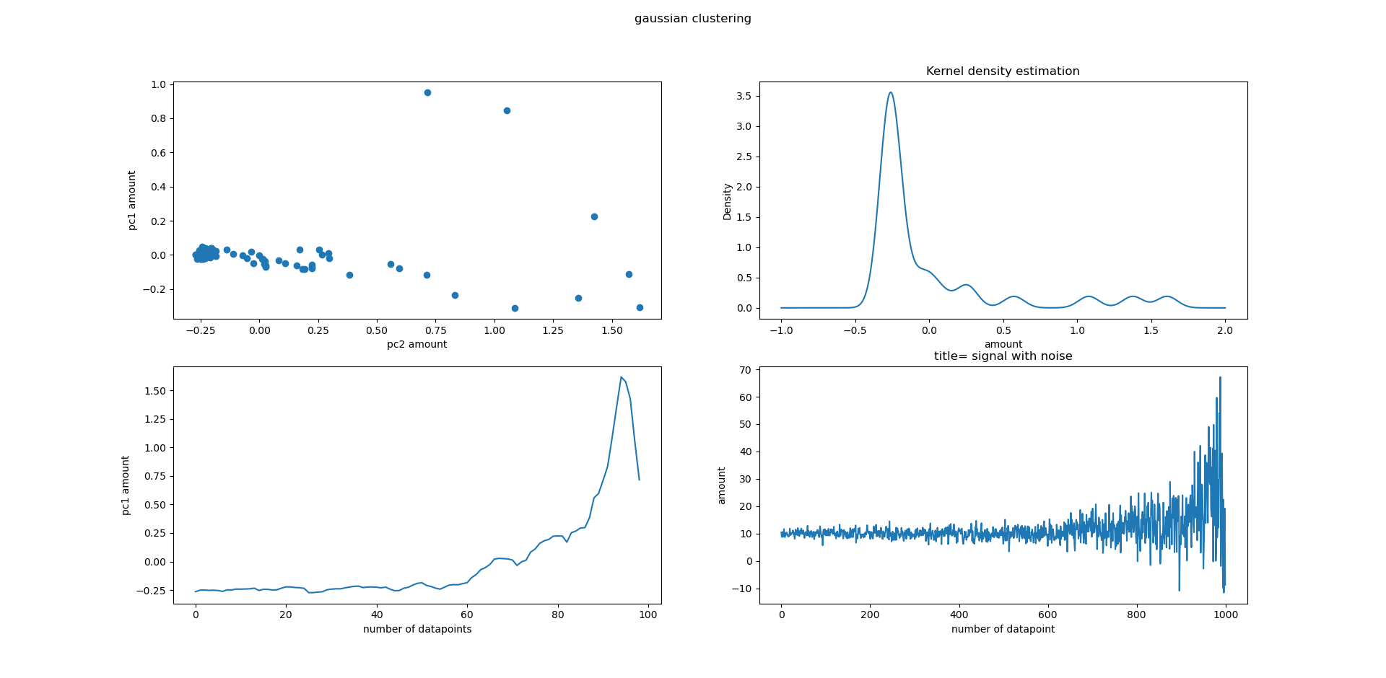

Slide 10
End

